Slide 1

GenerativeAI and Its Applications
Unit 1
(UE23CS342BA4)
NLP Basics, Terminologies and Task Overview
Dr. Pooja Agarwal
Dept. of CSE, PES University, Bangalore

Slide 2

Generative AI and its Applications
NLP Basics, Terminologies and Task Overview

Slide 3
GenerativeAI and Its Applications
Acknowledgement
The slides are prepared from various resources from the Universities from abroad and India. Also, some material is taken from reliable resources from internet throughout this course.

Slide 4
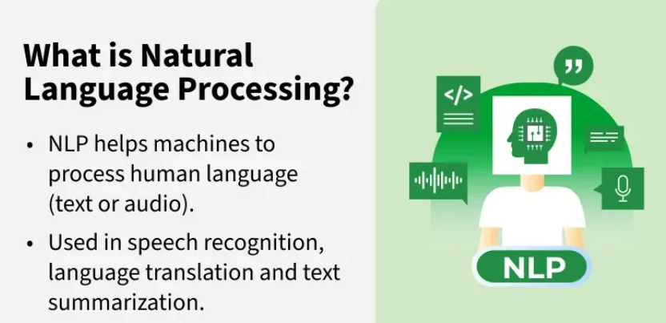
GenerativeAI and Its Applications
What is NLP
Natural Language Processing (NLP) is a branch of Artificial Intelligence (AI) that helps machines to understand and process human languages either in text or audio form. It is used across a variety of applications from speech recognition to language translation and text summarization.

Slide 5
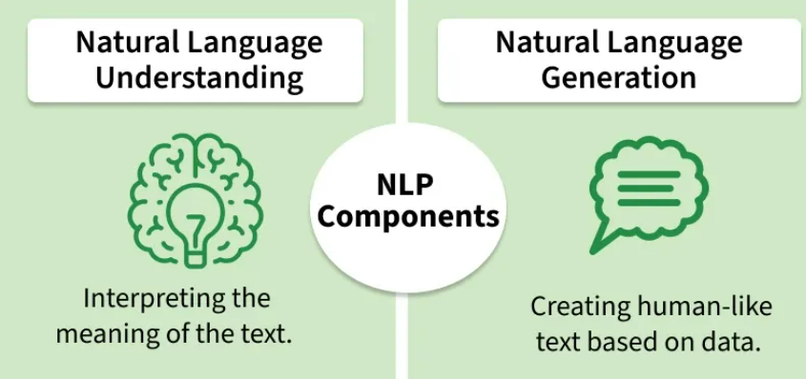
GenerativeAI and Its Applications
NLP Components

Slide 6
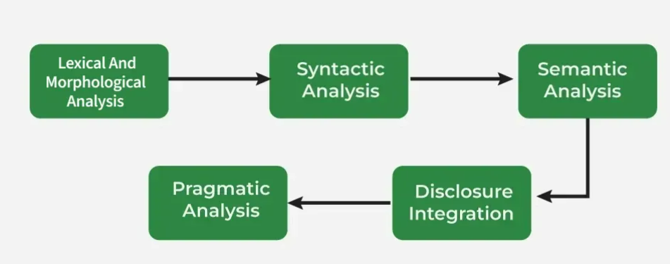
GenerativeAI and Its Applications
Phases of NLP
NLP involves a series of phases that work together to process language, and each phase helps in understanding structure and meaning of human language.
The arrangement of words in a sentence to make grammatical sense.
identifying and processing words (or lexemes) in a text
The meaning conveyed by a text.
The context in which a sentence is used.
The structure and coherence of a series of sentences.

Slide 7
GenerativeAI and Its Applications
Phases of NLP(Lexical and Morphological Analysis)
Lexical Analysis
It breaks down the input text into individual tokens that are meaningful units of language such as words or phrases.
Key tasks in Lexical analysis:
Tokenization: Process of dividing a text into smaller chunks called tokens. For example the sentence "I love programming" would be tokenized into ["I", "love", "programming"].
Part-of-Speech Tagging: Assigning parts of speech such as noun, verb, adjective to each token in the sentence. This helps us to understand grammatical roles of words in the context.
Consider the sentence: "I am reading a book."
Tokenization: Sentence is broken down into individual tokens or words: ["I", "am", "reading", "a", "book"]
Part-of-Speech Tagging: Each token is assigned a part of speech: ["I" → Pronoun (PRP), "am" → Verb (VBP), "reading" → Verb (VBG), "a" → Article (DT), "book" → Noun (NN)]
Morphological Analysis
It deals with morphemes which are the smallest units of meaning in a word. It is important to understand the structure of words and their parts by identifying free morphemes (independent words like "cat") and bound morphemes (like prefixes or suffixes e.g. "un-" or "-ing").
Key tasks in morphological analysis:
Stemming: Reducing words to their root form like "running" to "run".
Lemmatization: Converting words to their base or dictionary form considering the context like "better" becomes "good".

Slide 8
GenerativeAI and Its Applications
Phases of NLP (Syntactic Analysis (Parsing))
Syntactic Analysis helps in understanding how words in a sentence are arranged according to grammar rules.
It breaks the sentence into parts like the subject, verb and object and shows how these parts are connected. This helps machines understand the relationships between words in the sentence.
Key components of syntactic analysis include:
POS Tagging: Assigning parts of speech (noun, verb, adjective) to words in a sentence as discussed earlier.
Ambiguity Resolution: Handling words that have multiple meanings (e.g "book" can be a noun or a verb).
Consider the following sentences:
Correct Syntax: "John eats an apple."
Incorrect Syntax: "Apple eats John an."

Slide 9
GenerativeAI and Its Applications
Phases of NLP (Semantic Analysis)
Semantic Analysis focuses on understanding meaning behind words and sentences. It ensures that the text is not only grammatically correct but also logically coherent and contextually relevant.
Key Tasks in Semantic Analysis
Named Entity Recognition (NER): It identifies and classifies entities such as names of people, locations, organizations, dates and more. These entities provide important meaning in the text and help in understanding the context.
For example in the sentence "Tesla announced its new electric vehicle in California," NER would identify "Tesla" as an organization and "California" as a location.
Word Sense Disambiguation (WSD): Many words have multiple meanings depending on the context in which they are used. It identifies the correct meaning of a word based on its surrounding text.
For example word "bank" can refer to a financial institution or the side of a river. It uses context to identify which meaning applies in a given sentence which ensures that interpretation is accurate.

Slide 10
GenerativeAI and Its Applications
Phases of NLP (Discourse Integration)
It is the process of understanding how individual sentences or segments of text connect and relate to each other within a broader context.
This phase ensures that the meaning of a text is consistent and coherent across multiple sentences or paragraphs.
It is important for understanding long or complex texts where meaning focuses on previous statements.
Key aspects of discourse integration:
Anaphora Resolution: Anaphora refers to the use of pronouns or other references that depend on earlier parts of the text. For example in the sentence "Taylor went to the store. She bought groceries" pronoun "She" refers back to "Taylor." It ensures that references like these are correctly understood by linking them to their antecedents.
Contextual References: Many words or phrases can only be fully understood when considered in the context of following sentences. It helps in interpreting how certain words or phrases focuses on context. For example "It was a great day" is clearer when you know what event or situation is being discussed.
"This is unfair!" helps in understand what "this" refers to

Slide 11
GenerativeAI and Its Applications
Phases of NLP (Pragmatic Analysis)
Pragmatic analysis helps in understanding the deeper meaning behind words and sentences by looking beyond their literal meanings. It considers the speaker's or writer's intentions, tone and context of the communication.
"Hello! What time is it?" here it might be a straightforward request for the current time but it could also imply concern about being late.
For example "I’m falling for you" means "I like you" not literally falling. It helps to interpret these non-literal meanings.

Slide 12
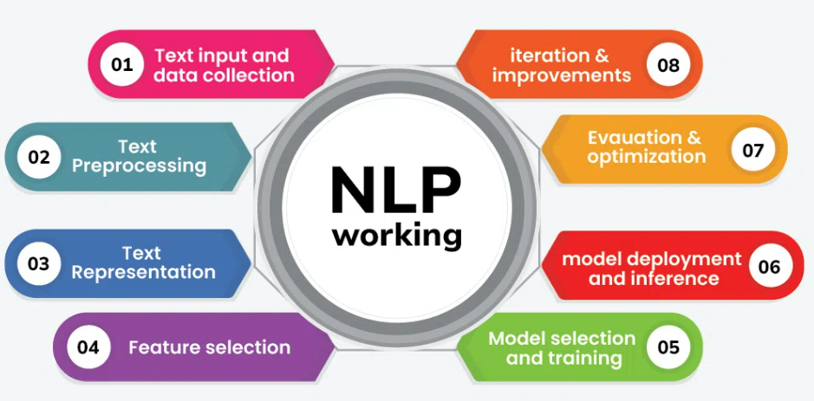
GenerativeAI and Its Applications
How NLP Works

Slide 13
GenerativeAI and Its Applications
How NLP Works
Text Input and Data Collection
Data Collection: Gathering text data from various sources such as websites, books, social media or proprietary databases.
Data Storage: Storing the collected text data in a structured format, such as a database or a collection of documents.
Text Preprocessing
Preprocessing is crucial to clean and prepare the raw text data for analysis. Common preprocessing steps include:
Tokenization: Splitting text into smaller units like words or sentences.
Stopword Removal: Removing common words that do not contribute significant meaning, such as "and," "the," "is."
Stemming and Lemmatizations: Reducing words to their base or root forms. Stemming cuts off suffixes, while lemmatization considers the context and converts words to their meaningful base form.
Text Normalization: Standardizing text format, including correcting spelling errors, expanding contractions and handling special characters.

Slide 14
GenerativeAI and Its Applications
How NLP Works
Text Representation
Bag of Words: Representing text as a collection of words, ignoring grammar and word order but keeping track of word frequency.
Term Frequency – Inverse Document Frequency (TF-IDF): A statistic that reflects the importance of a word in a document relative to a collection of documents.
Word Embedding: Using dense vector representations of words where semantically similar words are closer together in the vector space (e.g., Word2Vec, GloVe).
Feature Selection
Extracting meaningful features from the text data that can be used for various NLP tasks.
N-grams: Capturing sequences of N words to preserve some context and word order.
Syntactic Features: Using parts of speech tags, syntactic dependencies and parse trees.
Semantic Features: Leveraging word embeddings and other representations to capture word meaning and context.

Slide 15
GenerativeAI and Its Applications
How NLP Works
Model Selection and Training
Selecting and training a machine learning or deep learning model to perform specific NLP tasks.
Supervised Learning: Using labeled data to train models like Support Vector Machines (SVM), Random Forests or deep learning models like Convolutional Neural Networks (CNNs) and Recurrent Neural Networks (RNNs).
Unsupervised Learning: Applying techniques like clustering or topic modeling (e.g., Latent Dirichlet Allocation) on unlabeled data.
Pre-trained Models: Utilizing pre-trained language models such as BERT, GPT or transformer-based models that have been trained on large corpora.
Model Deployment and Inference
Deploying the trained model and using it to make predictions or extract insights from new text data.
Text Classification: Categorizing text into predefined classes (e.g., spam detection, sentiment analysis).
NER: Identifying and classifying entities in the text.
Machine Translation: Translating text from one language to another.
Question Answering: Providing answers to questions based on the context provided by text data.

Slide 16
GenerativeAI and Its Applications
How NLP Works
Evaluation and Optimization
Using metrics such as accuracy, precision, recall, F1-score and others.
Hyperparameter Tunning: Adjusting model parameters to improve performance.
Error Analysis: Analyzing errors to understand model weaknesses and improve robustness.

Slide 17
GenerativeAI and Its Applications
Text Representation and Embedding Techniques
Text Representation Techniques
It converts textual data into numerical vectors that are processed by the following methods:
One-Hot Encoding
Bag of Words (BoW)
Term Frequency- Inverse Document Frequency (TF-IDF)
N-Gram Language Modelling
Latent Semantic Analysis (LSA)
Latent Dirichlet Allocation (LDA)
Text Embedding Techniques
It refers to methods that create dense vector representations of text, capturing semantic meaning including advanced approaches like:
Word Embedding: Word2Vec (SkipGram, CBoW), Glove, FastText
Pre-Trained Embedding: ELMO, BERT
Document Embedding: Doc2Vec
Advanced Embedding: RoBERTa, DistillBERT

Slide 18
GenerativeAI and Its Applications
Libraries of NLP
Some of Natural language processing libraries include:
NLTK
SpaCy
TextBlob
Transformers (by Hugging face)
Gensim

Slide 19
GenerativeAI and Its Applications
Applications of NLP
Text Classification in NLP
Semantic Analysis: Determining the sentiment or emotional tone expressed in a text (e.g., positive, negative, neutral).
Topic Modelling: Identifying topics or themes within a large collection of documents.
Spam Detection: Classifying text as spam or not spam.
Language Generation
Machine Translation: Translating text from one language to another.
Text Summarization: Producing a concise summary of a larger text.
Text Generation: Automatically generating coherent and contextually relevant text.
c

Slide 20
GenerativeAI and Its Applications
Applications of NLP
Speech Processing
Speech Recognition: Converting spoken language into text.
Text-to-Speech Synthesis: Converting Written Text into Spoken Language
Question Answering
Retrieval Based QA: Finding and returning the most relevant text passage in response to a query.
Generative QA: Generating an answer based on the information available in a text corpus.

Slide 21
GenerativeAI and Its Applications
Applications of NLP
Dialogue Systems
Chatbot and Virtual Assistants: Enabling systems to engage in conversations with users, providing responses and performing tasks based on user input.
Sentiment and Emotion Analysis
Emotion Detection: Identifying and categorizing emotions expressed in text.
Opinion Mining: Analyzing opinions or reviews to understand public sentiment toward products, services or topics.
Multilingual NLP: Expanding NLP to support more languages, including regional and minority languages, broadens accessibility.

Slide 22
Thank You

